Slide 1
Our title

Slide 2
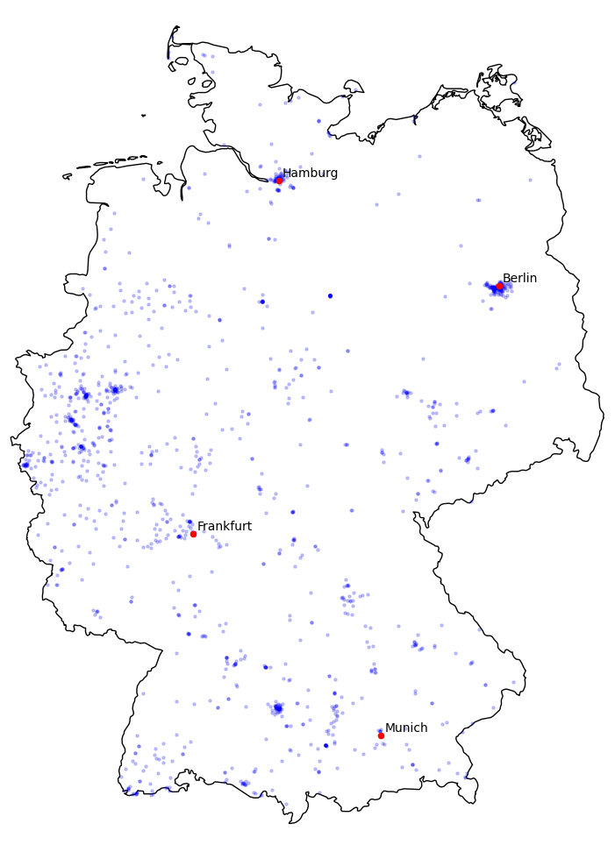

Slide 3
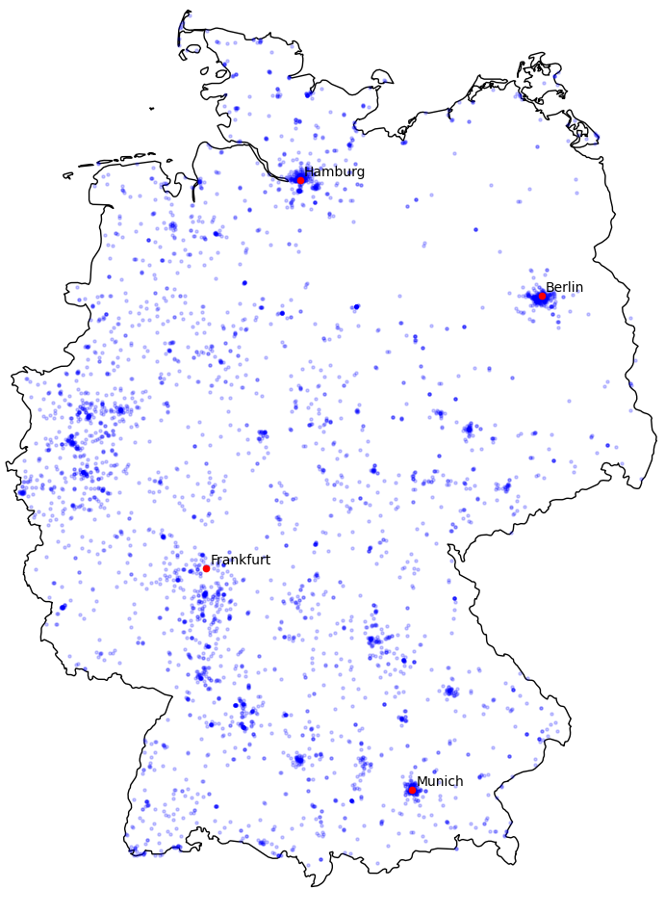

Slide 4
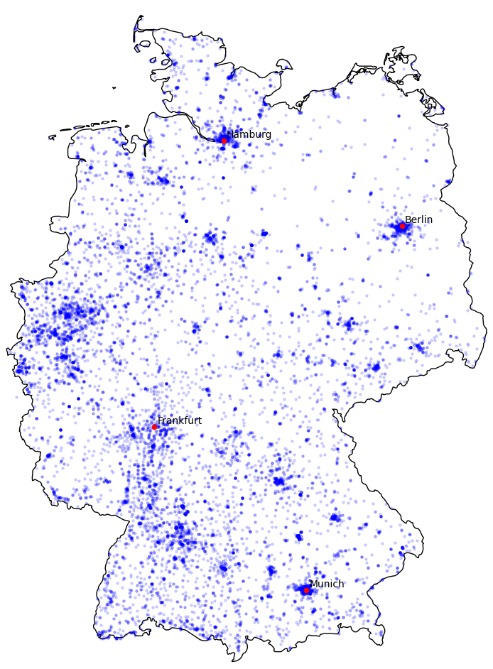

Slide 5
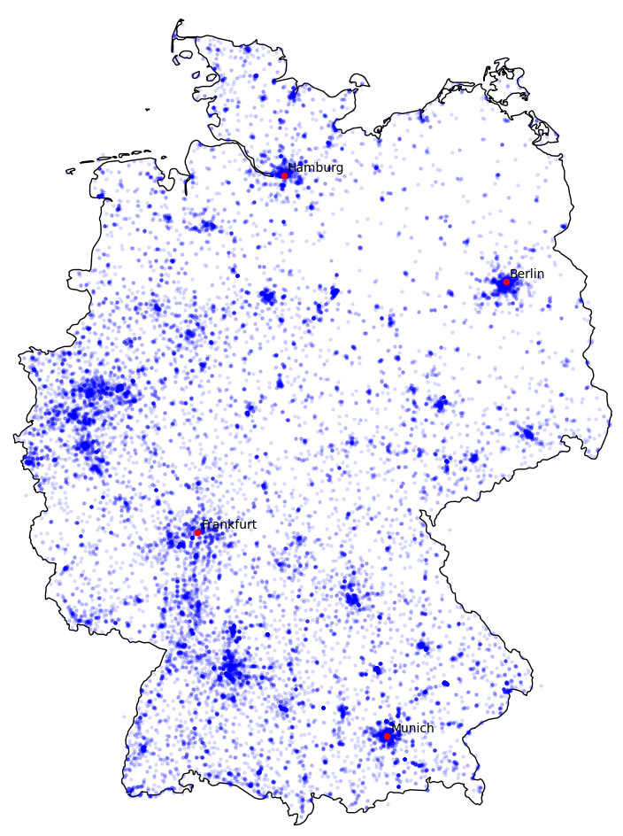

Slide 6
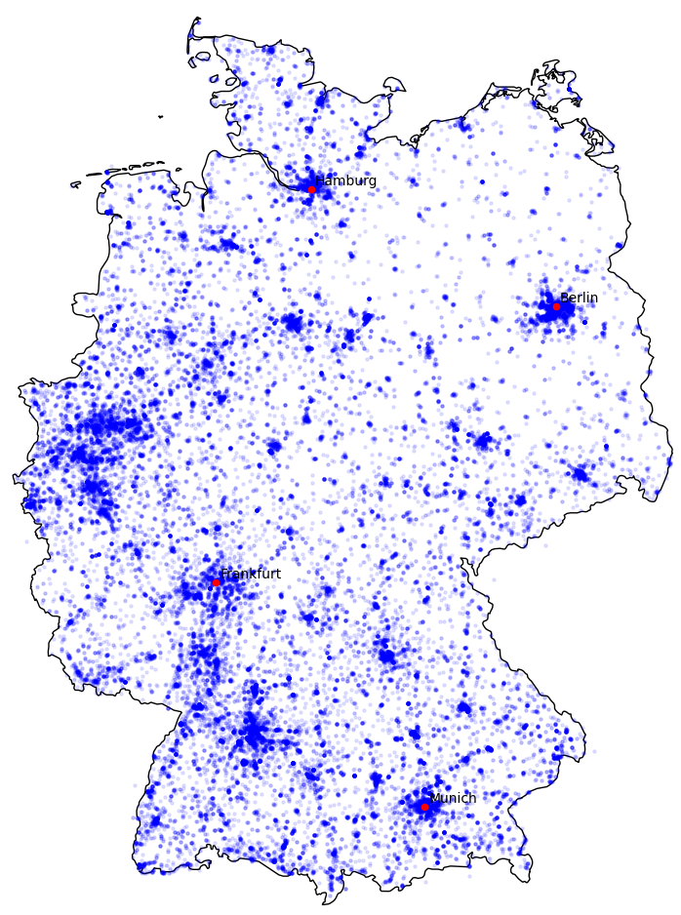

Slide 7
Pareto I

Slide 8
Pareto II

Slide 9
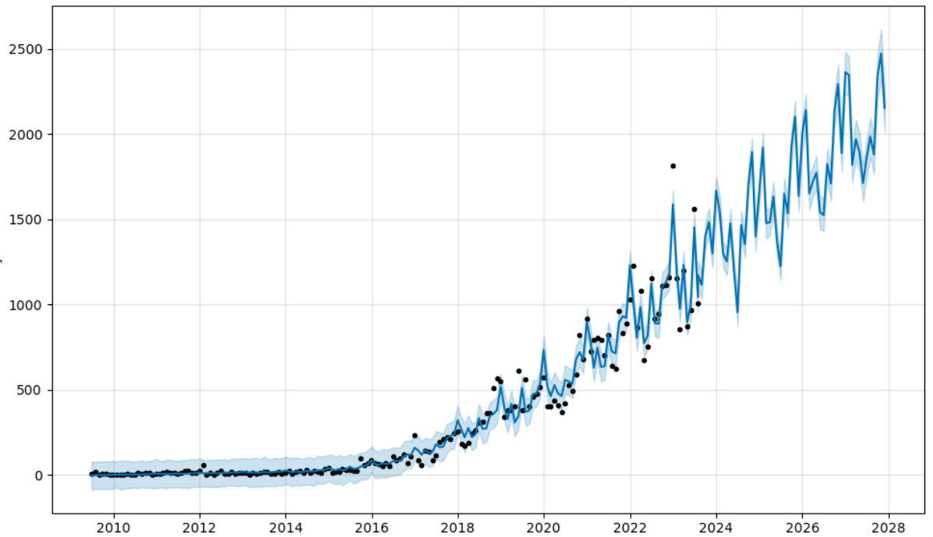
Projection
Charging stations until 2028

Slide 10
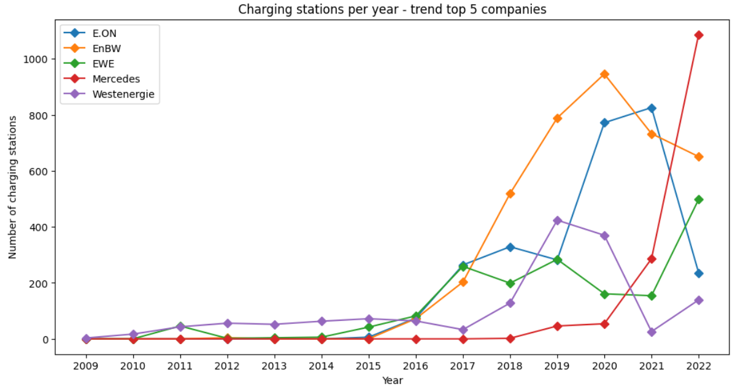
Main provider
Charging stations per year – trend top 5 provider

Slide 11
Thank you for the attention

